Slide 1




Profiling and Detecting Bottlenecks in Software
Bryan Call
OSCON 2011
Yahoo! Engineer and Apache Commiter

Slide 2
Overview
Why profile your code?
Rules of thumb
Profiling pitfalls
Types of bottlenecks
Basic command line tools
What is a profiler?
Types of profilers
Profiling Examples
Ways to improve performance

Slide 3
Why profile your code?
Better understanding of your application and architecture
Reduced hardware and maintenance costs
  Less hardware to setup and maintain
Learn how to be a better coder
Look smart

Slide 4
Rule of thumb
80/20 rule
  80% of the runtime using only 20% of the code
  Some people say 90/10

Slide 5
Profiling pitfalls
Pre-optimization, waist of time
  Optimizing the 80% of the code that only runs 20% of the time
  Don’t fully understand the architecture or workload
Over optimize code
  Can overcomplicate code

Slide 6
Types of Bottlenecks
CPU
Disk
Network
Memory
Lock contention
External resources
  Databases, web service, etc..

Slide 7
Basic Command-line Tools
top, htop (great for threaded apps)
vmstat, dstat
strace
time
Notes:
Some utilities I use to track down what is the bottleneck for applications – I use dstat, htop, and strace a lot. I will use time for a quick test to see if how much system vs user time an application is using

Slide 8
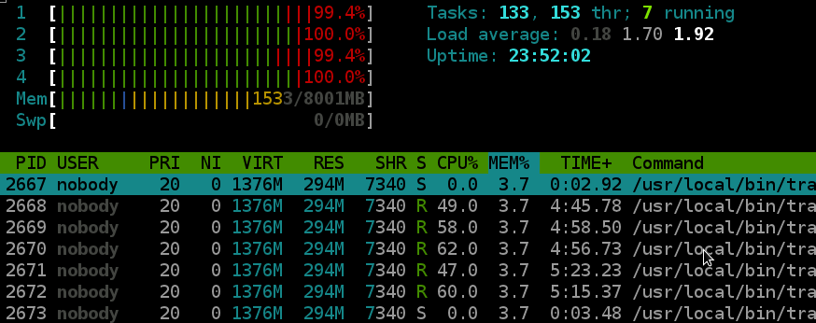
htop Example
4 core server

Slide 9
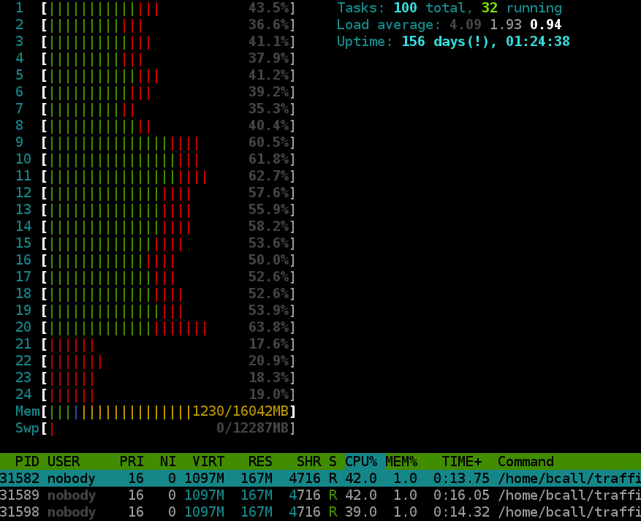
htop Example
24 “core” – 12 core with hyper-threading

Slide 10
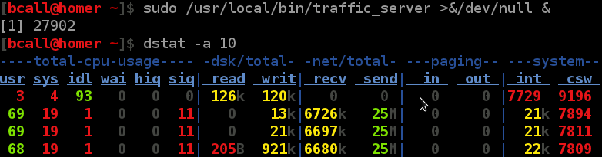
dstat Example – CPU bottleneck
Apache Traffic Server – 470B objects in cache
Notes:
Cpu is the bottleneck for apache traffic server in this example – network is about ¼ of the nic and hardly any disk io

Slide 11
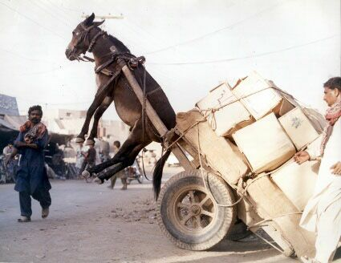
Understand Your Workload
Changing the workload can change the bottleneck

Slide 12
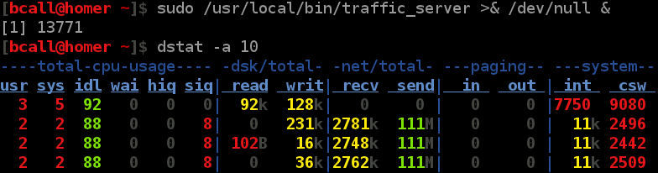
dstat Example – Network bottleneck
Apache Traffic Server – 200KB object in cache
Notes:
If your application looks similar to this it is pointless to optimize the code – 4% CPU used and 2% user – think about NIC bonding or 10gige

Slide 13
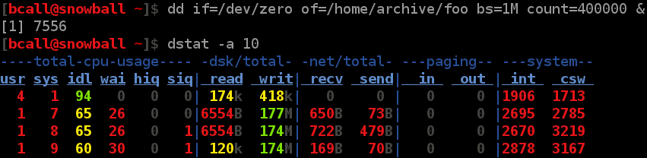
dstat Example – Disk bottleneck
dd - /dev/zero to raid0 (two drives)
Notes:
2 things to note– disk writes are a bottleneck and we are using 7 to 9 times as much system time then user time – again pointless to optimize code if you are bottlenecked on hardware – think about a better raid, ssds, or compression before writing to disk

Slide 14
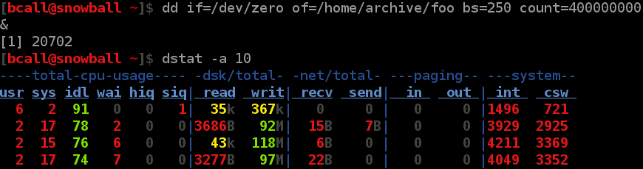
dstat Example - syscall issue
Writes are too small and can’t max out the disk
Notes:
8x system over user and writes are down from ~175MB/sec
Story about boost logging – memory allocation & small writes even on separate writer thread
Story about interleaving small writes in the kernel

Slide 15
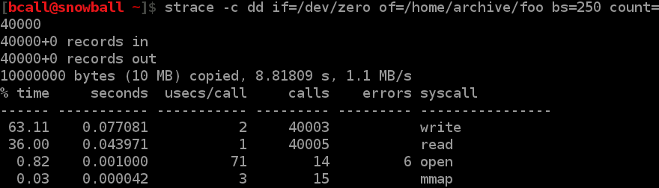
strace Example
Effects performance ~100MB/sec to 1.1MB/sec
Notes:
Performance change is exaggerated because of the number of system calls

Slide 16
What is a Profiler?
Dynamic program analysis
Shows
  Frequency of functions called
  Usage of lines in code
  Duration of function calls

Slide 17
Types of Profilers
Statistical
  Examples: oprofile, google profiler
  Good for interactive systems with lots of code
  Doesn't slow down the application much (1% to 8%)
  Fixed cost
    Doesn't take up more CPU as the number of function calls per second increases
Notes:
----- Meeting Notes (7/25/11 21:01) -----
Doesn't effect user experience

Slide 18
Types of Profilers
Instrumenting
  Examples: valgrind's callgrind, gprof
  More detail (time for each function call)
  Can make programs much slower
  Good for non-interactive systems

Slide 19
Oprofile
Requires kernel driver, need root access
System wide profiling, profiles everything running
Application doesn’t know about the profiler
Scripts to convert output for kcachegrind

Slide 20
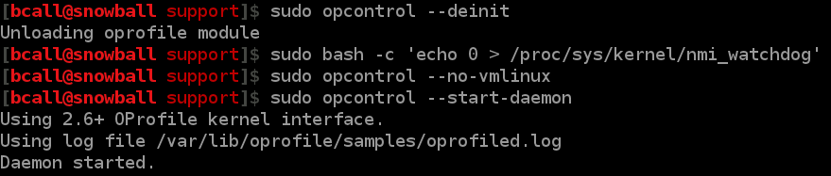
Oprofile Example
Profiling ab (Apache Bench)
30K rps with profiler, 32K rps without

Slide 21
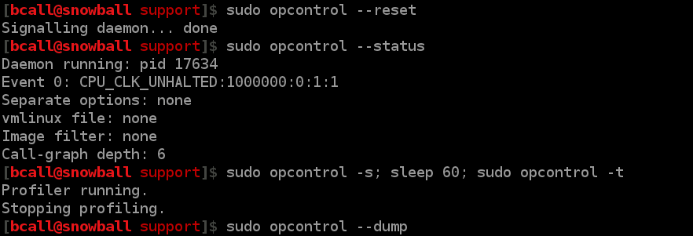
Oprofile Example

Slide 22
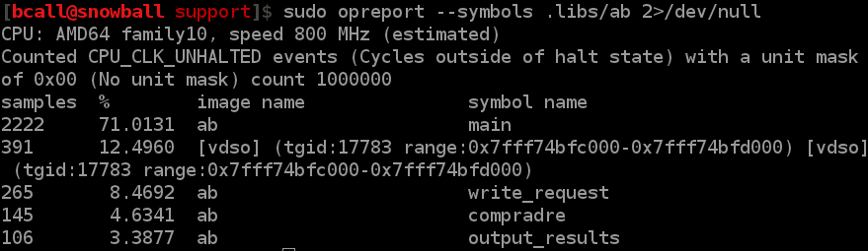
Oprofile Example

Slide 23
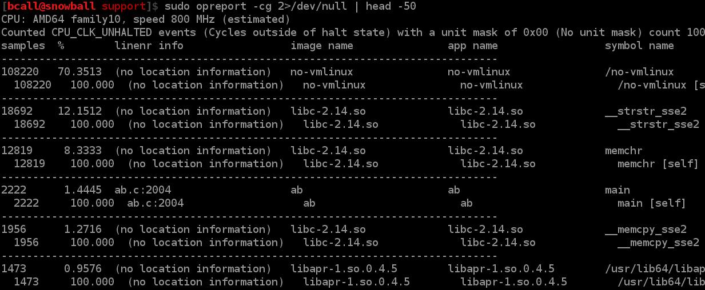
Oprofile Example
Showing everything that was running

Slide 24
Google profiler
All in userland
Profiles specific applications, not system wide
Command-line LD_PRELOAD support
Support to build it into your application
Has graphing built in

Slide 25

Google Profiler Example
Profiling ab (Apache Bench)
30K rps with profiler, 32K rps without
Notes:
Really didn’t slow down ab much

Slide 26
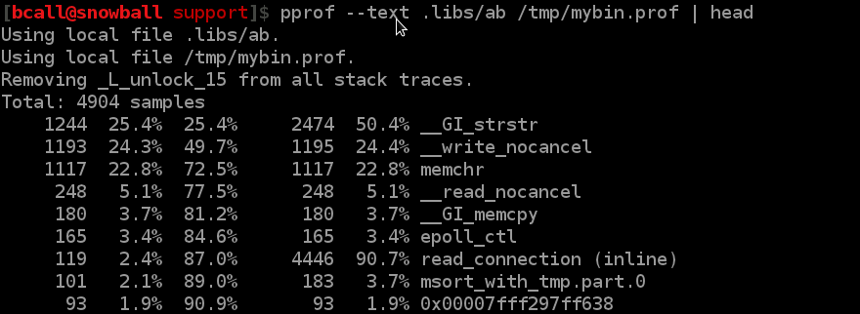
Google Profiler Example

Slide 27
Google Profiler Example
Making a diagram of the profile

Slide 28
Google Profiler Example

Slide 29
Google Profiler Example

Slide 30
Vagrind’s callgrind
All in userland
Requires no code changes
Really slows down your application
Lots of detail since it is not sampling

Slide 31
callgrind Example
Running callgrind on ab (Apache Bench)
1.6K rps with profiler, 32K rps without - 95% slower

Slide 32
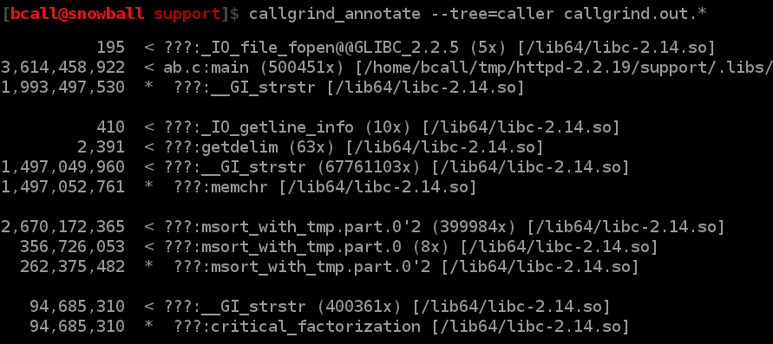
callgrind Example

Slide 33
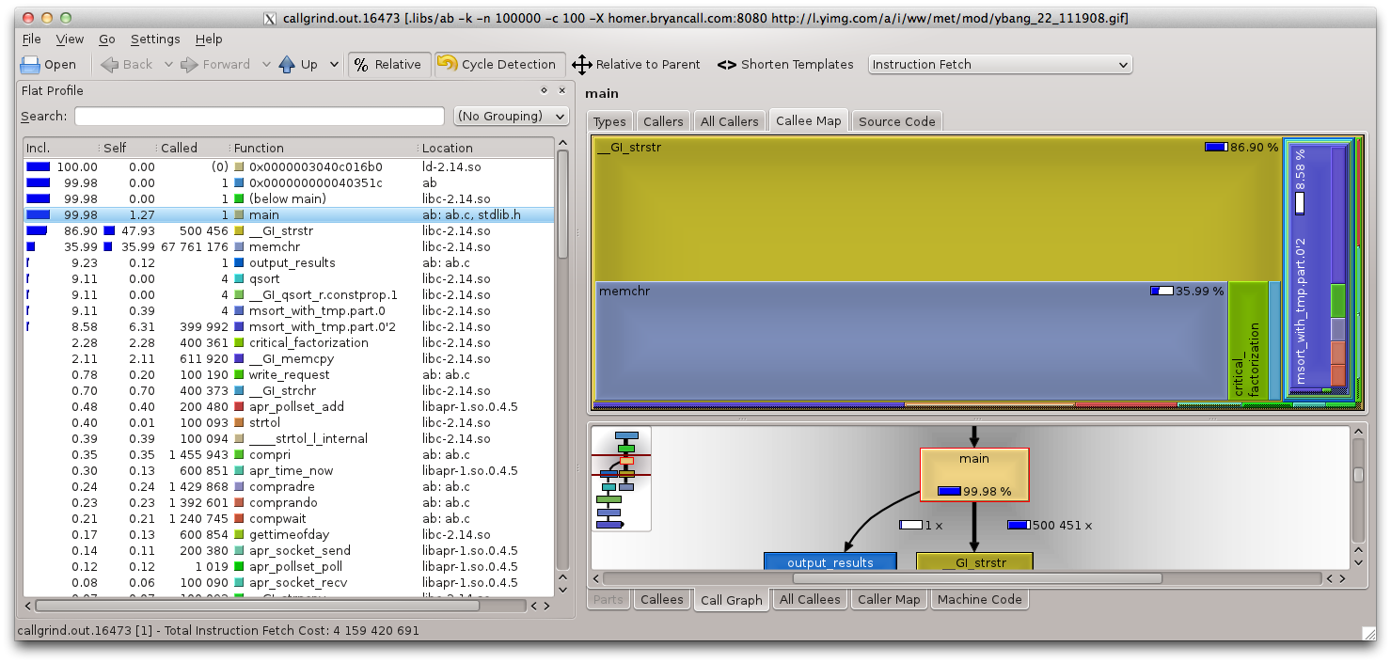
callgrind Example - kcachegrind

Slide 34
Recap
Understand your workload
Find your bottleneck
Profile

Slide 35
Ways to Improve Performance
Caching
  Don't do the same work twice
Choose the correct algorithms and data structures
  dqueue vs list, hash vs trees, locks vs read/write locks, bloom filter
Memory allocation
  Reuse memory, stack vs heap, tcmalloc
Make fewer system calls
  Larger writes and reads
Faster hardware
  Bonded NICs, SSDs or RAID, CPU more cores

Slide 36
References
Email: bcall@apache.org
How to profile ATS
  https://cwiki.apache.org/TS/profiling.html

Slide 37
Links to Software
dstat
  http://dag.wieers.com/home-made/dstat/
htop
  http://htop.sourceforge.net/
oprofile
  http://oprofile.sourceforge.net/news/
google profiler (part of the prof tools)
  http://code.google.com/p/google-perftools/
callgrind
  http://valgrind.org/docs/manual/cl-manual.html
kcachegrind
  http://kcachegrind.sourceforge.net/html/Home.html

Slide 38
Appendix
setup httpd/ab:
cd ~/tmp/
wget http://mirror.candidhosting.com/pub/apache//httpd/httpd-2.2.19.tar.bz2
tar xf httpd-2.2.19.tar.bz2
cd httpd-2.2.19
./configure
gmake -j 8
cd support

Slide 39
Appendix
oprofile commands:
# at the start - only need to this once after reboot - because of watchdog timers
sudo opcontrol --deinit
sudo bash -c 'echo 0 > /proc/sys/kernel/nmi_watchdog'
sudo opcontrol --no-vmlinux
sudo opcontrol --start-daemon
sudo opcontrol --reset
sudo opcontrol --status
# in another terminal run ab - needs to run for 60 seconds, increase -n if need be
.libs/ab -k -n 2000000 -c 100 -X homer.bryancall.com:8080 http://l.yimg.com/a/i/ww/met/mod/ybang_22_111908.gif
sudo opcontrol -s; sleep 60; sudo opcontrol -t
sudo opcontrol --dump
sudo opreport --symbols .libs/ab 2>/dev/null
sudo opreport -cg 2>/dev/null | head -50

Slide 40
Appendix
google profiler commands:
export CPUPROFILE=/tmp/mybin.prof
LD_PRELOAD="/usr/lib64/libprofiler.so" .libs/ab -k -n 2000000 -c 100 -X homer.bryancall.com:8080 http://l.yimg.com/a/i/ww/met/mod/ybang_22_111908.gif
pprof --text .libs/ab /tmp/mybin.prof | head
pprof --pdf .libs/ab /tmp/mybin.prof > ~/Desktop/ab.pdf

Slide 41
Appendix
callgrind commands:
rm -f callgrind.out.* # clean up anything there
valgrind --tool=callgrind .libs/ab -k -n 100000 -c 100 -X homer.bryancall.com:8080 http://l.yimg.com/a/i/ww/met/mod/ybang_22_111908.gif
callgrind_annotate --tree=caller callgrind.out.*
kcachegrind callgrind.out.*

Slide 42
Notes
Had problems with --separate=lib or --separate=thread not changing output on Fedora Core 15

